Slide 1
How Motor Carriers Really Buy Fuel
Presented by Gary Markham
Director of Regulatory Compliance
ProMiles Software

Slide 2
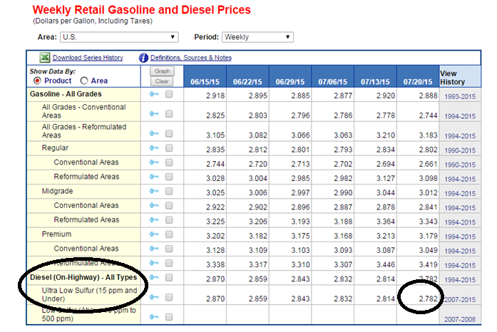
Energy Information Administration (EIA) or Department of Energy (DOE)

Slide 3
Who is the DOE
The DOE is a government agency
Created by The Federal Energy Administration Act of 1974
Created to address the energy shortage of the 70’s

Slide 4
Gas lines from the 1970’s

Slide 5
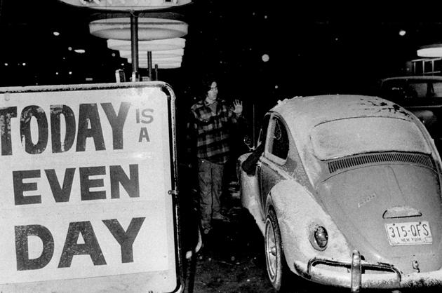
Gas lines from the 1970’s

Slide 6
Gas lines from the 1970’s

Slide 7
DOE Does More Than Averages
Responsible for
Short/Long Term Energy Outlook
Reporting on
Natural Gas
Drilling Productivity
Electric Power
Petroleum Supply
Petroleum Marketing
Monitor Biodiesel Production

Slide 8
DOE Does More
So…They do much more…
Than just publishing an average weekly fuel price
But…
How is the Weekly Average calculated?

Slide 9
How is it calculated?

Slide 10
How is it calculated?
350 Retail pricing locations are polled
Locations scattered across five PADDS
Weekly price – each Monday
Retail price only

Slide 11
Problems with the average
What are the problems with the DOE average?

Slide 12
There are problems with the average
350 locations out of more than 7,000

Slide 13
There are problems with the average
DOE Average vs. Lane on 7/20/2015

Slide 14
There are problems with the average
DOE Average vs. Lane on 7/24/2015

Slide 15
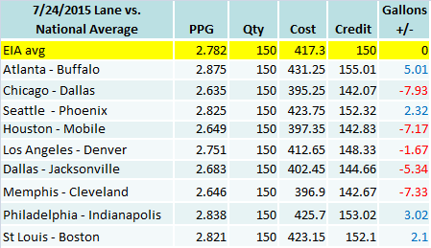
There are problems with the average

Slide 16
Have I peaked your interest yet!
But Wait!!!
There’s More!!!

Slide 17
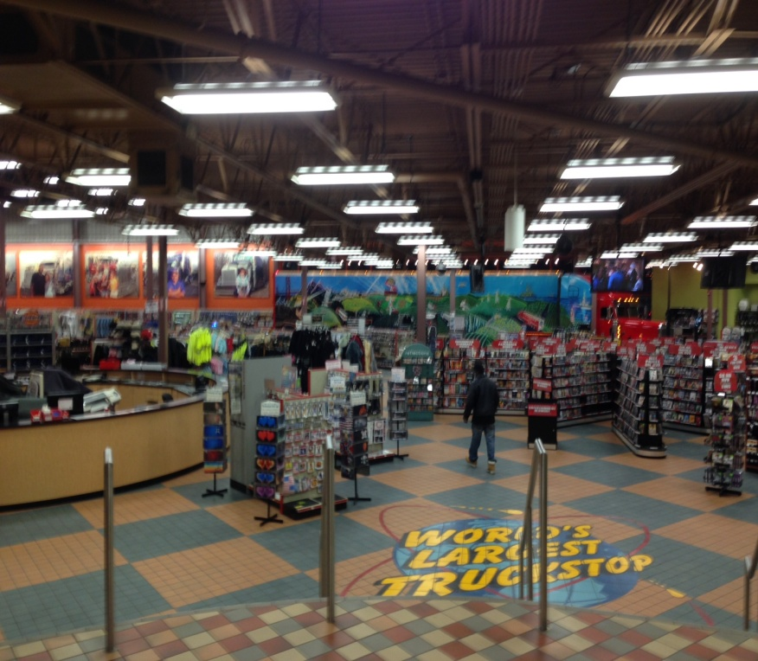
What Do Carriers Pay For Fuel
Not Retail!
Why?
Truck stops want to funnel drivers into the stores >>>>

Slide 18
Truck Stop Margins
Truck stops do have margins on fuel
They are willing to give up a portion of that margin
To sell items with a higher margin

Slide 19
High Margin Items

Slide 20
How Do Carriers Get Discounts
Fuel discounts come from several sources
Negotiated discounts with truck stop chains
Owner operators get discounts thru carriers
Leasing companies offer branded cards that allow the carrier to take advantage of the leasing company’s buying power.

Slide 21
What Does This Mean To You?
Assuming a discount of 10 cents per gallon
How will this impact the estimated gallons?
How will it impact the truck’s MPG?

Slide 22
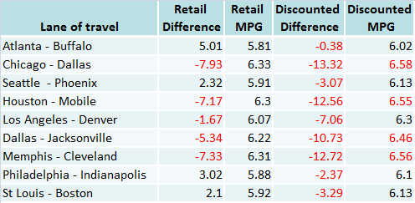
The Impact

Slide 23
Conclusion
I’m not suggesting we stop estimating fuel
I am suggesting we –
Look at a carrier’s lanes of travel
Use regional averages instead of a national
Use a daily average price when we can
And ask the carrier if they have a fuel discount program

Slide 24
Q&A Time
Thanks for Your Time
Gary Markham
Director of Regulatory Compliance
ProMiles Software
(205)854-0146
gary@promiles.com

